Slide 1


Online Student Marks Parent SMS Alerting System
This system provides parents with real-time updates on their child's academic performance through automated SMS alerts. It seamlessly integrates student data, notification triggers, and secure communication channels to ensure parents are informed and engaged in their child's educational journey.

Slide 2
System Architecture Overview
Database
Backend
Frontend
The system utilizes a SQLite database to store student marks, contact information, and notification preferences.
The backend is developed using Python and the Flask web framework, responsible for data management and SMS integration.
The user interface is built with HTML and CSS, providing a clean and intuitive experience for parents and administrators.

Slide 3

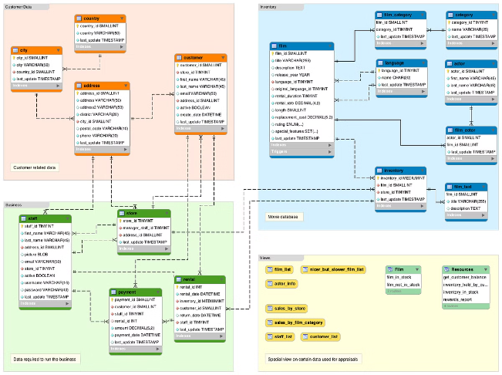
Database Design
1
Student Information
Stores student personal details, including name, ID, and contact information.
2
Marks and Assessments
Records student scores, grades, and performance metrics for various subjects and assessments.
3
Parent Profiles
Maintains parent contact details and notification preferences for each student.
4
Notification Logs
Tracks the history of SMS alerts sent to parents regarding their child's progress.

Slide 4
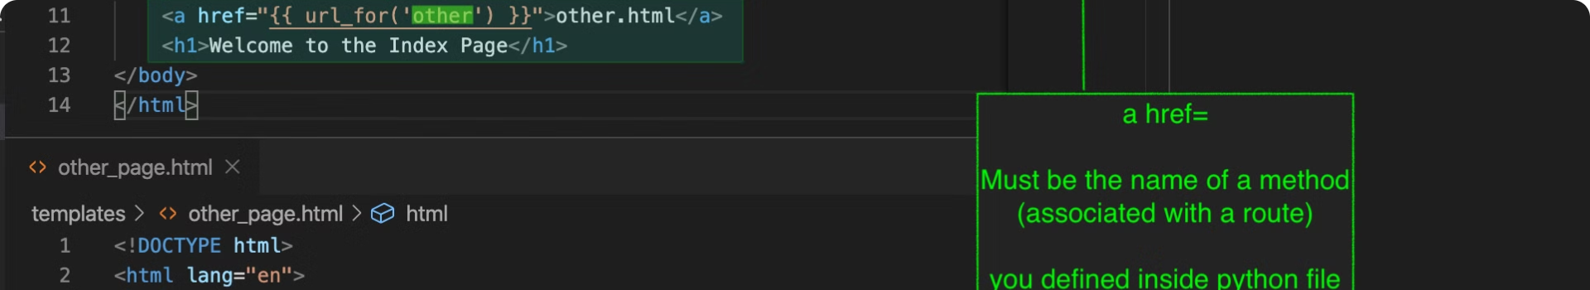
Backend Development
Data Management
Notification Triggers
Responsible for CRUD operations on student, parent, and marks data using MYSQL queries.
Monitors student performance and initiates SMS alerts based on predefined thresholds.
Twilio Integration
Security and Privacy
Seamlessly integrates with the Twilio API to deliver automated SMS notifications to parents.
Ensures data security and privacy through robust access controls and encryption mechanisms.

Slide 5
Frontend Implementation
Student Marks Dashboard
Notification Settings
Responsive Design
Provides a user-friendly interface for parents to view their child's academic progress.
Allows parents to customize their notification preferences, such as alert thresholds and contact details.
Ensures a seamless experience across desktop, tablet, and mobile devices for maximum accessibility.

Slide 6





Twilio Integration
Automated SMS
Twilio's SMS API enables the system to send real-time alerts to parents regarding their child's performance.
Scalable Infrastructure
Twilio's cloud-based platform ensures reliable and scalable delivery of notifications to parents.
Secure Communication
The integration leverages Twilio's security features to protect sensitive student and parent data.

Slide 7

Student Marks Management
Data Entry
1
Teachers and administrators can securely input student scores and grades into the system.
2
Performance Tracking
The system monitors student performance and tracks their academic progress over time.
Reporting and Analytics
3
Generate comprehensive reports and insights to identify trends and inform educational decisions.

Slide 8





Parent Notification Process
Trigger Criteria
The system continuously evaluates student performance against predefined notification criteria.
SMS Delivery
When a trigger is met, the system automatically sends an SMS alert to the parent's registered mobile number.
Parental Engagement
Parents can review their child's progress and respond to the alerts, fostering active involvement.

Slide 9


Security and Privacy
1
Data Encryption
All student and parent data is encrypted both at rest and in transit to ensure privacy.
2
Access Controls
Role-based access permissions limit user access to sensitive information based on their responsibilities.
3
Audit Logging
The system maintains comprehensive logs of all user actions and data modifications for accountability.
4
Compliance and Regulations
The system adheres to relevant data protection laws and industry standards to safeguard information.

Slide 10

Future Enhancements and Scalability
Multilingual Support
Expand the platform to support multiple languages, catering to diverse parent communities.
Mobile App Integration
Develop a dedicated mobile application for parents to access student data and notifications on-the-go.
Predictive Analytics
Implement machine learning algorithms to identify patterns and provide proactive intervention recommendations.
Scalable Infrastructure
Ensure the system can handle growing user and data volumes without compromising performance.

